Slide 1
Lecture 1
Adventures in statistics

Slide 2
Jan Hannig
330 Hanes Building
jan.hannig@unc.edu,
(919) 962-7511
Personal webpage http://www.unc.edu/~hannig
Course webpage http://www.unc.edu/~hannig/STOR054

Slide 3
Course Webpage
http://www.unc.edu/~hannig/STOR054
Sakai@UNC
http://sakai.unc.edu
Check grades through Gradebook
Make sure you have the correct email address on file to receive email announcements.

Slide 4
Strategy for Success
Stay active/involved in class.
Ask questions during class (especially if you can not understand something).
Do not feel shy or inadequate (you are not the only one …)
Answer questions to help other students if you can.
Keep pace with the discussions, do homework to help understand the materials, do R exercises yourself!.
Make effective use of office hours
Help you to answer questions about homework and R
Private time vs. public time
You already paid for this service, so why not use it?

Slide 5
To Know YOU Better and Quicker
Talk with me before or after class
Concerns about this “mathematics” class
Suggestions to improve the lectures
Things you like and dislike
Come to my office (during office hours or not)
Hanes 330
M 2:30-3:30PM W 11:00 – 12:00noon
Office hours: open-door, no appointments needed
Call (919.962.7511)
Email (jan.hannig@unc.edu).
Sakai Discussions
Ask and answer questions in class.

Slide 6
Where am I from?
Can you venture a guess?

Slide 7
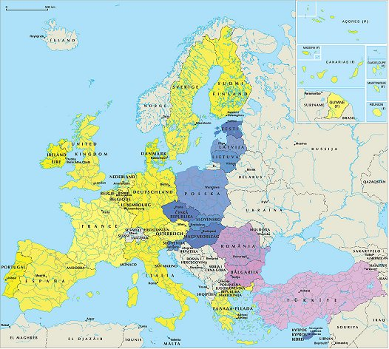
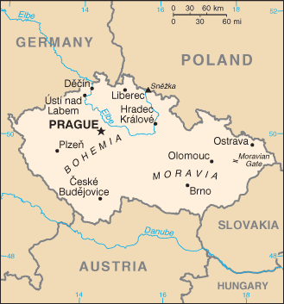
Czech Republic

Slide 8

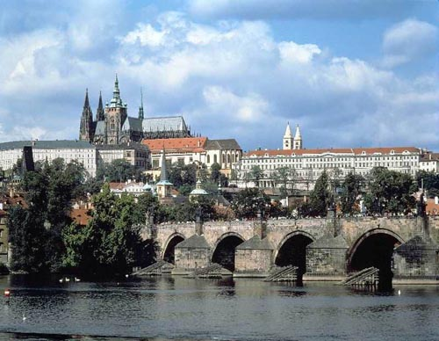

Prague

Slide 9


Michigan State

Slide 10
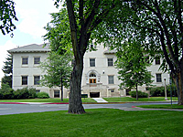


Colorado State

Slide 11
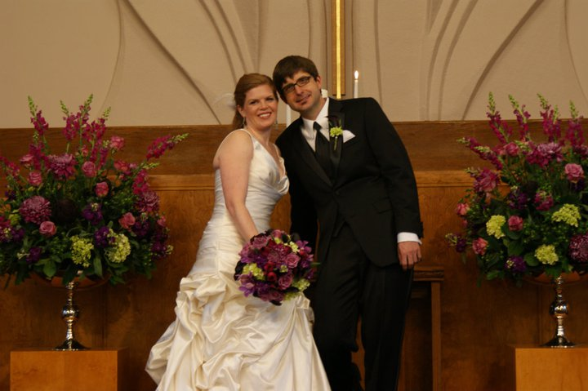
Married to Shevaun Neupert

Slide 12
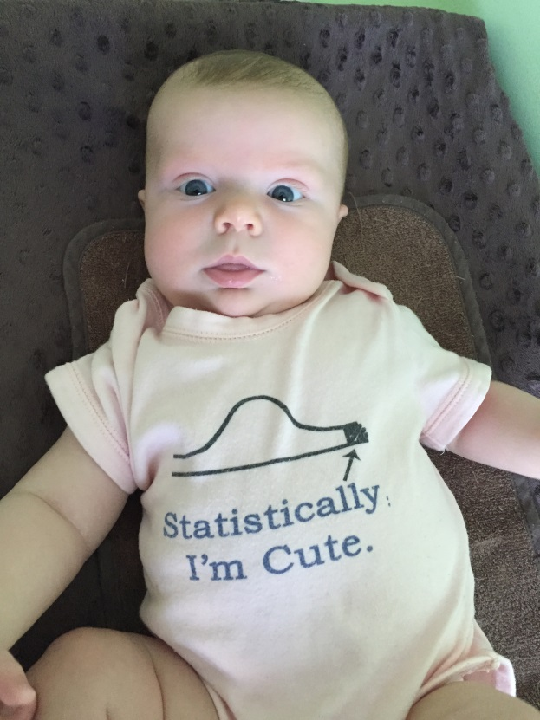
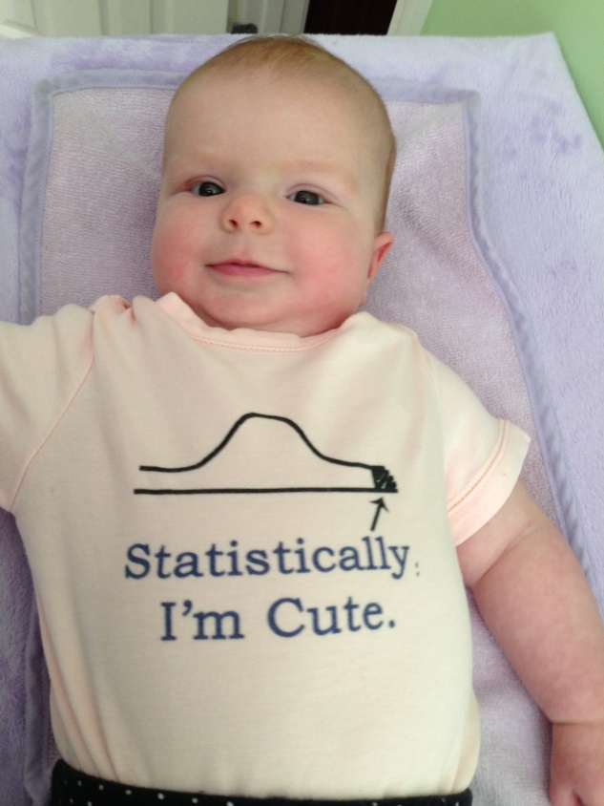
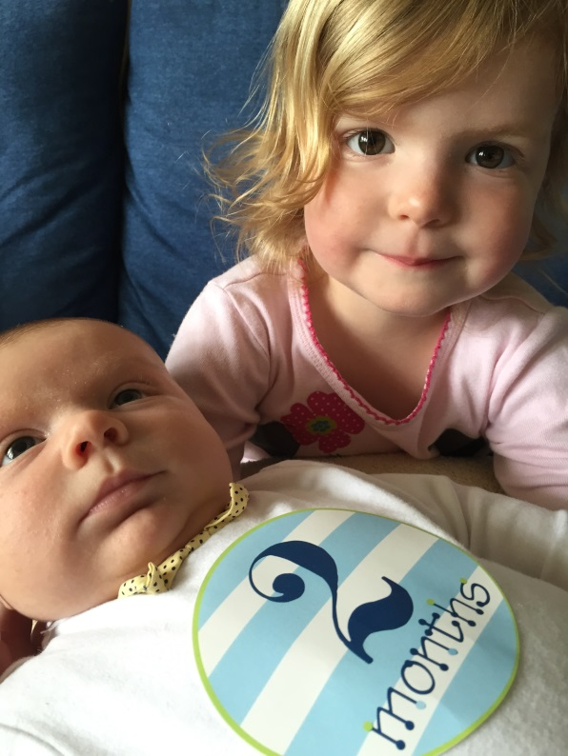
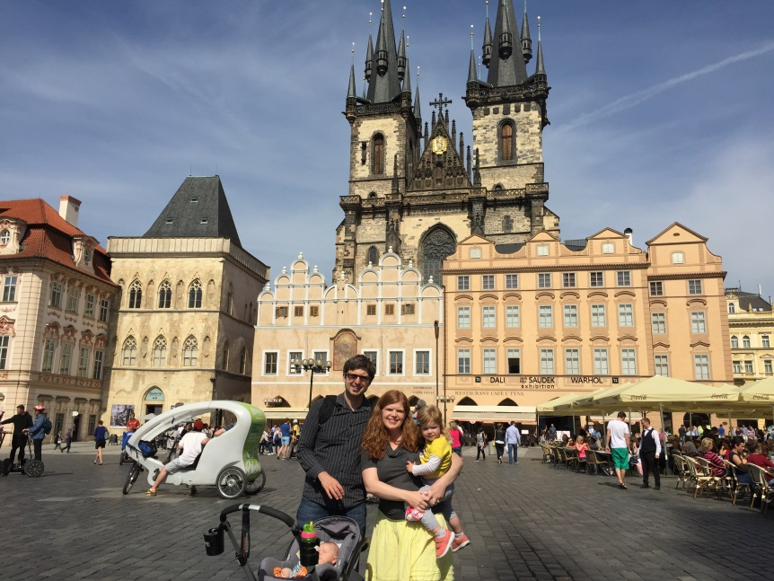
Klára and Declan

Slide 13

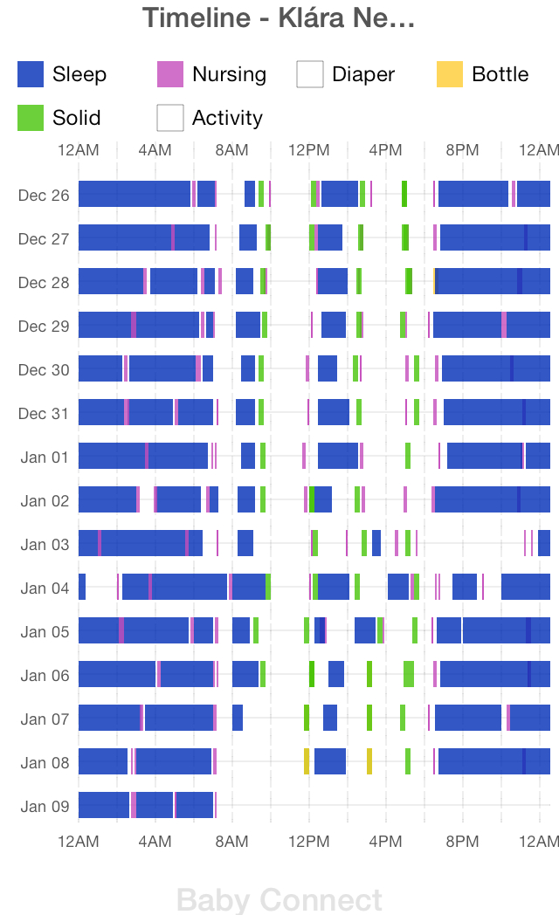
She is 3.5

Slide 14

He is 1.5

Slide 15
Interests
Mountain biking
Cello
My church (Greenleaf Vineyard)
Of course
Research
Teaching

Slide 16
Tell me about you
Where are you from?
What made you select this FYS?

Slide 17
Statistics
Science of data
Description of reality
Prediction of unobserved quantities
Uncertainty quantification

Slide 18
Perception
A lot of people do not like statistics
My wife says I teach statistics
but is a professor of psychology

Slide 19
Brainstorming
Where do you think statistics shows up in our lives and why?

Slide 20
Statistics in sports
http://fivethirtyeight.com/features/the-high-school-football-coach-who-never-punts/

Slide 21
Fun with data
Fivethirtyeight.com
Fun Data Podcasts: http://fivethirtyeight.com/tag/fivethirtyeight-podcasts/
Any other data sites you like?

Slide 22
Homework
Due Thursday 9/1
During next week pay attention to ways data and statistics intersect your life.
Write a short report (at most 2 pages) on what you have observed.

Slide 23
R requirement
We will use program called R
Download it for free from http://www.r-project.org
Who has done any programing/coding before?

